Slide 1
Dream/Wakefulness classification through LLM
Enzo Gerbelot-Legris

Slide 2
Project Overview
Better characterizing hypnagogia
Develop an operational classification prompt capable of discriminating dream vs Hypnagogia based on text content.
(On reports of dream and Hypnagogia, Célia’s work)

Slide 3
Project Overview
Better characterizing hypnagogia
Develop an operational classification prompt capable of discriminating dream vs Hypnagogia based on text content.
(On reports of dream and Hypnagogia, Célia’s work)
Dataset : ~ 150 Dream and Hypnagogic reports

Slide 4
Project Overview
Better characterizing hypnagogia
Develop an operational classification prompt capable of discriminating dream vs Hypnagogia based on text content.
(On reports of dream and Hypnagogia, Célia’s work)
First step : Model (Claude AI) capable of discriminating Dream vs Wakefulness reports

Slide 5
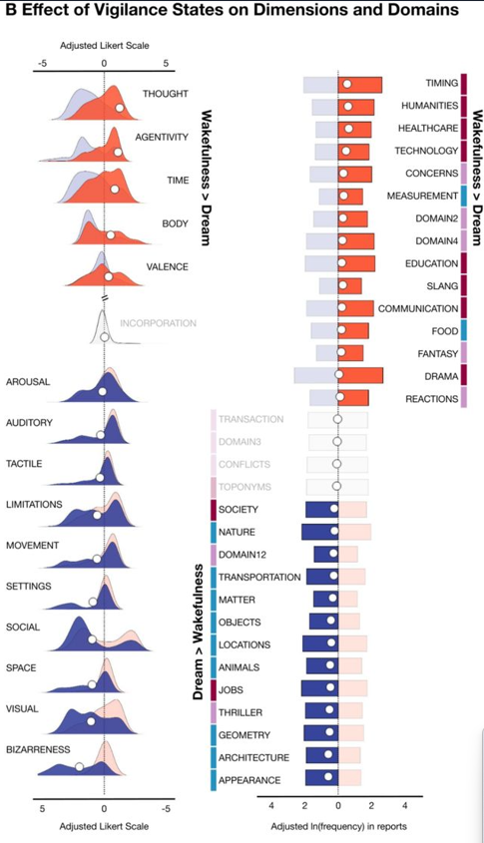
Project Overview
Based on your semantic analysis of dream and wakefulness report
Another question analysis: Is AI able to discriminate dream vs wakefulness ?
(Fig1 B, Elce et al. 2025)

Slide 6
Reports used
Wakefulness reports N=42
Spotify podcast transcription of autobiographical report :
« And that’s really when I was blown away by those tropical glacier landscapes… »
Autobiographical book : Rousseau and Pepy’s autobiographies
Online self life event report on blog (Reddit)
Dreams reports N=42

Slide 7
Reports used
Wakefulness reports N=42
Spotify podcast transcription of autobiographical report :
« And that’s really when I was blown away by those tropical glacier landscapes… »
Autobiographical book : Rousseau and Pepy’s autobiographies
Online self life event report on blog (Reddit)
Dreams reports N=42
Dream Reports of Kirberg et al., 2026 :
« I'm in a little boat and it is all made out of Lego, the toy Lego and I'm looking around me trying to figure out why everything around me seems to be made of Lego »
My own dream journal and dream

Slide 8
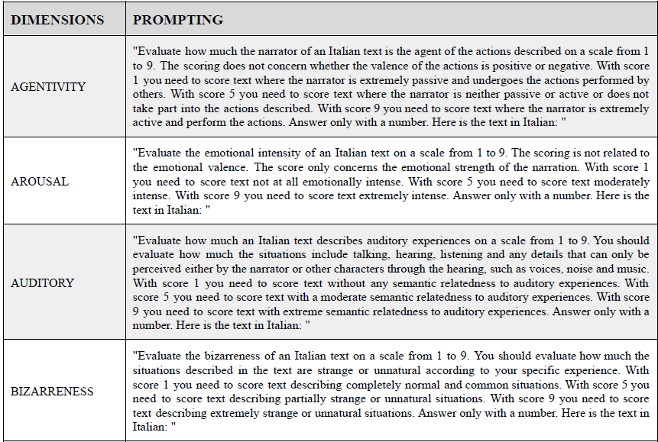
Dream/Wakefulness Score
Score formula based on cohen’s d score of differences between vigilance states and dimensions weight
Score = Σ(scored_dimension_i × weight_i)
(TabS1 Supp Data, Elce et al. 2025)

Slide 9
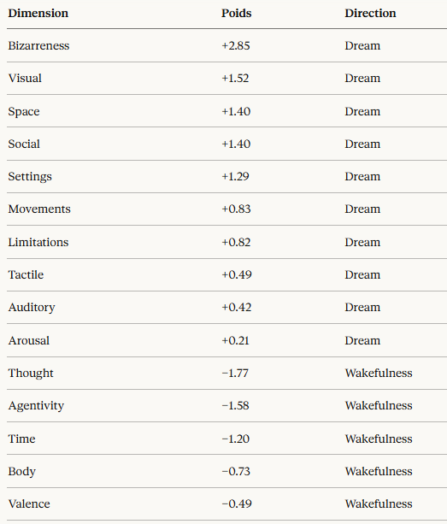
Dream/Wakefulness Score
Score formula based on cohen’s d score of differences between vigilance states and dimensions weight
Score = Σ(scored_dimension_i × weight_i)

Slide 10
Dream/Wakefulness Score
Score = Σ(scored_dimension_i × weight_i)
« I was flying »
Scorables dimensions :
BIZARRENESS = 10, weight = +2.85 → +28.50
VISUAL = 5, weight = +1.52 → +7.60
MOVEMENTS = 7, weight = +0.83 → +5.81
BODY = 4, weight = −0.73 → −2.92
Score = 28.50 + 7.60 + 5.81 − 2.92 = +39.00

Slide 11
Performance
84 reports scored for now
Overall Precision : 74/84 = 88%
9 errors → only 1 Dream report misscored as Wakefulness

Slide 12
The semantics of dreams
Questions :
What are the principal dimensions relevant for AI scoring ?

Slide 13
The semantics of dreams
Questions :
What are the principal dimensions relevant for AI scoring ?
Does it match your determined dimensions ?

Slide 14
The semantics of dreams
Questions :
What are the principal dimensions relevant for AI scoring ?
Does it match your determined dimensions ?
Does the dimensions are homogenous across individuals ?

Slide 15
Subsidary questions
Questions :
Does the domains can be different in other language or culture ?
What is the best way to normalize the score to suppress the length report bias

Slide 16
Supplementary Data

Slide 17
Normalised Discriminant Score
NDS RAW Score = Σ(score_i × weight_i)
To avoid bias of report length size → Normalisation : DENOM = Σ|weight_i|

Slide 18
Normalised Discriminant Score
NDS RAW Score = Σ(score_i × weight_i)
To avoid bias of report length size → Normalisation : DENOM = Σ|weight_i|
NDS = RAW / DENOM

Slide 19
Normalised Discriminant Score
NDS RAW Score = Σ(score_i × weight_i)
To avoid bias of report length size → Normalisation : DENOM = Σ|weight_i|
NDS = RAW / DENOM
« I was flying »
Scorables dimensions :
BIZARRENESS = 10, weight = +2.85 → +28.50
VISUAL = 5, weight = +1.52 → +7.60
MOVEMENTS = 7, weight = +0.83 → +5.81
BODY = 4, weight = −0.73 → −2.92
RAW = 28.50 + 7.60 + 5.81 − 2.92 = +39.00 DENOM = 2.85 + 1.52 + 0.83 + 0.73 = 5.93 NDS = 39.00 / 5.93 = +6.58

Slide 20
Performance
182 reports scored for now
Overall Precision : 178/182 = 97.8%
4 errors are from the corpus of Dream and Mind wandering reports (Kirberg 2026) : 71/75 = 94.7%
4 false negative : Realistic dreams scored as wakefulness – low confidence and ambiguous zone

Slide 21
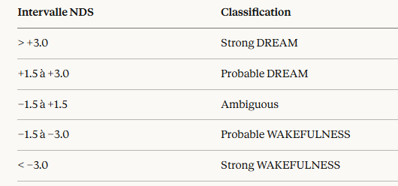
The ambiguous zone
100% Accuracy for NDS < -3 and > +3

Slide 22
Lexical Adjustment
Performance measures of the GLME model for the prediction of lexical domains across vigilance states → 32 Lexical domain with Cohen’s d. (table S4, Elche 2025)
Statistical association between lexical domain and vigilance states

Slide 23
Lexical Adjustment
Performance measures of the GLME model for the prediction of lexical domains across vigilance states → 32 Lexical domain with Cohen’s d. (table S4, Elche 2025)
Statistical association between lexical domain and vigilance states
18 Lexical domain used (statistical significance)
Domaines dream-favoring (exemples) :
APPEARANCE (+0.30), ARCHITECTURE/GEOMETRY (+0.25), ANIMALS (+0.25), LOCATIONS (+0.20), THRILLER (+0.20)
Domaines wakefulness-favoring (exemples) :
TIMING (−0.40), HUMANITIES (−0.25), HEALTHCARE (−0.25), TECHNOLOGY (−0.20)
Allow a better judgement in ambiguous zone

Slide 24
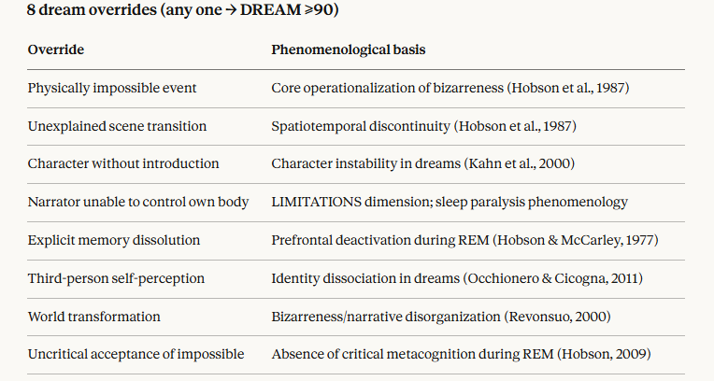
Structural Overrides
Overrides : discrete, binary rules designed to capture dream and wakefulness features that are immediately diagnostic to a human scorer.
Can overpass NDS ambiguous zone.
8 Overrides in dreams – 1 is enough to assess dream
4 Overrides in wakefulness – 4 need to be present to assess wakefulness

Slide 25
Structural Overrides
Overrides : discrete, binary rules designed to capture dream and wakefulness features that are immediately diagnostic to a human scorer.
Can overpass NDS ambiguous zone.
8 Overrides in dreams – 1 is enough to assess dream
4 Overrides in wakefulness – 4 need to be present to assess wakefulness
4 overrides → WAKEFULNESS ≥90 :
Explicit temporal réference
Métacognitive process
Narrator is actively initiating all key actions deliberately
None bizarre or impossible event or element

Slide 26
Performance
004_21 — Scored as WAKEFULNESS, True = DREAM
"I was imagining my life in a future in a way that I was imagining all the things I had to do. I was kind of imagining the tasks that I needed to do. Seeing myself as if from the outside doing these tasks, I can't really remember what these tasks were, but it was around this theme of maybe like maybe I need to educate myself some more and maybe I need to talk to this person or do that thing.“
NDS = -1,06 (probable wakefulness) and trigger wakefulness override :
Explicit temporal réference
Métacognitive process
Narrator is actively initiating all key actions deliberately
None bizarre or impossible event or element

Slide 27
Limits
Overall need more data especially of wakefulness reports to improve :
NDS thresholds
Overrides and lexical adjustment may need improvement or change

